Slide 1
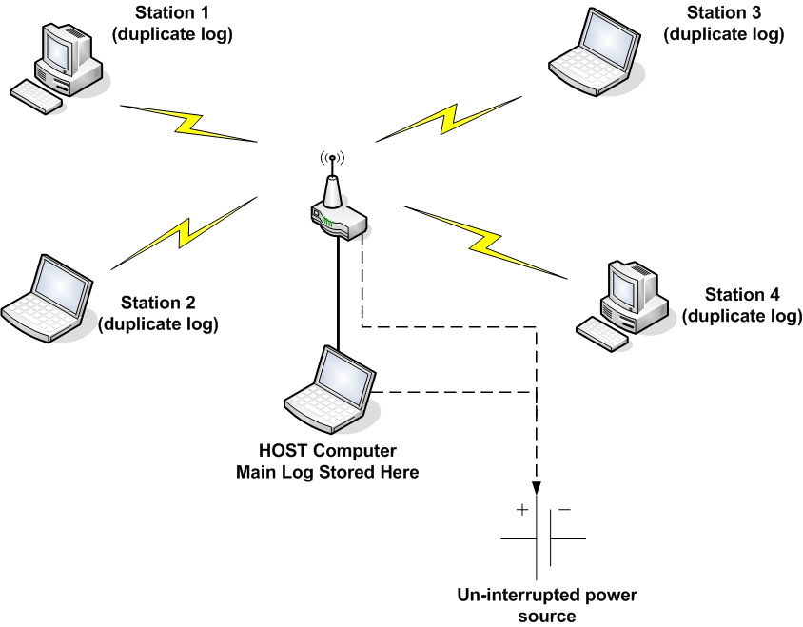
W6EK Field Day Log Configuration

